Slide 1
FACTORY DESIGN PATTERN
Creational Design Pattern

Slide 2
TABLE OF CONTENTS
01
03
02
04
Definition
UML Diagram
Types
Java Code

Slide 3
01
WHAT IS FACTORY DESIGN PATTERN

Slide 4

FACTORY DESIGN PATTERN
Factory Pattern is a creational design pattern that provides an interface for creating objects in a super class, but allows subclasses to alter the type of objects that will be created. It abstracts the process of object creation.

Slide 5
02
TYPES OF FACTORY DESIGN PATTERN

Slide 6
FACTORY DESIGN TYPES
01.Simple Factory Pattern
02.Factory Method Pattern
03.Abstract Factory Pattern

Slide 7
Simple Factory Pattern
In simple factory pattern, we have a factory class which has a method that returns different types of object based on given input.
The client code asks this class to create an object without knowing the details of the object's creation.

Slide 8
Factory Method Pattern
A Factory Method Pattern says that just define an interface or abstract class for creating an object but let the subclasses decide which class to instantiate.
The client code asks this class to create an object without knowing the details of the object's creation.

Slide 9
Abstract Factory Pattern
Abstract Factory provides an interface for creating families of related objects without specifying their concrete classes.
It's used when you need to create multiple related objects that work together.

Slide 10
03
EXAMPLE AND IT’S UML DIAGRAM

Slide 11

EXAMPLE
In a virtual gaming world, we need a system to create different characters with unique abilities dynamically. We'll implement the Factory Design Pattern to achieve this, allowing us to create warriors, mages, and archers seamlessly. Each character type will have specific behaviors, and the system should be flexible enough to add new character types in the future without modifying existing code.

Slide 12
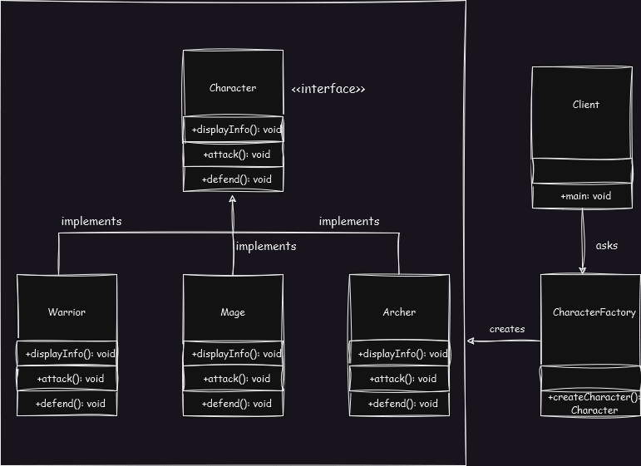
UML Diagram

Slide 13
04
JAVA CODE

Slide 14
SUPER CLASS (INTERFACE)/ABSTRACT CLASS
interface Character
{
void displayInfo();
void attack();
void defend();
}

Slide 15
CONCRETE CLASS
class Warrior implements Character {
public void displayInfo() { System.out.println("Warrior : Strength"); }
public void attack() { System.out.println("Warrior strikes!"); }
public void defend() { System.out.println("Warrior shields!"); }
}

Slide 16
CONCRETE CLASS
class Mage implements Character {
public void displayInfo() { System.out.println(“Mage : Magic"); }
public void attack() { System.out.println(“Mage Cast!"); }
public void defend() { System.out.println(“Mage Protects!"); }
}

Slide 17
CONCRETE CLASS
class Archer implements Character {
public void displayInfo() { System.out.println(“Archer : Precision"); }
public void attack() { System.out.println("Warrior shoots!"); }
public void defend() { System.out.println("Warrior dodges!"); }
}

Slide 18
FACTORY CLASS
class CharacterFactory {
static Character createCharacter(String characterType) {
switch (characterType) {
case "Warrior": return new Warrior();
case "Mage": return new Mage();
case "Archer": return new Archer();
default: System.out.println("Invalid character type. Creating a default character."); return new Warrior();
}
}
}

Slide 19
FACTORY CLASS
public class Main {
public static void main(String[] args) {
Character warrior = CharacterFactory.createCharacter("Warrior");
warrior.displayInfo();
warrior.attack();
warrior.defend();
Character mage = CharacterFactory.createCharacter("Mage");
mage.displayInfo();
mage.attack();
mage.defend();
} }

Slide 20
THANKS!
Do you have any questions?

